Slide 1
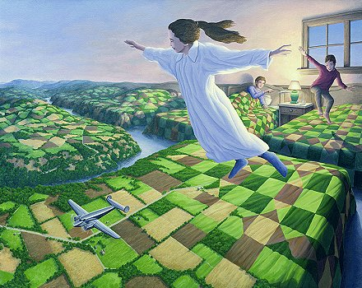

Slide 2
Exam Review
Let’s take up the results:
AVI1OX

Slide 3

A) Matching
B)
1. Interrupted Lines

Slide 4
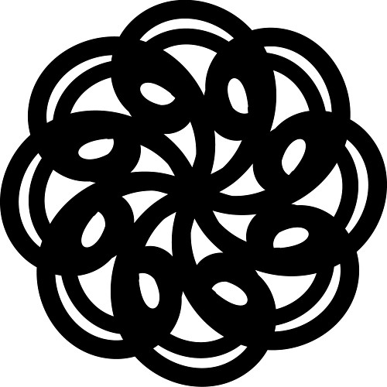
A) Matching
D)
2. Thick Line

Slide 5

A) Matching
F)
3. S-Shaped Lines

Slide 6
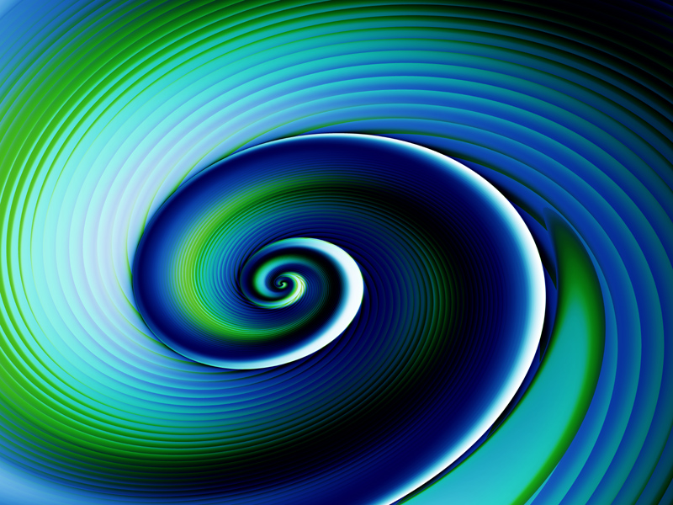
A) Matching
H)
4. Spiral

Slide 7
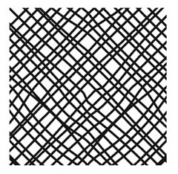
A) Matching
G)
5. Cross-Hatching

Slide 8
A) Matching
A)
6. Horizontal Lines

Slide 9
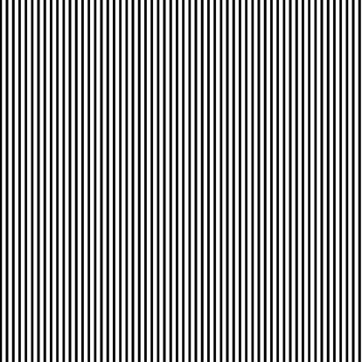
A) Matching
J)
7. Vertical Lines

Slide 10
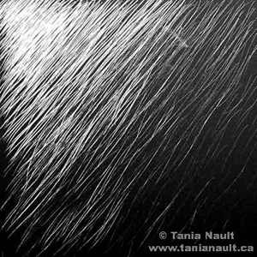
A) Matching
C)
8. Hatching Lines

Slide 11
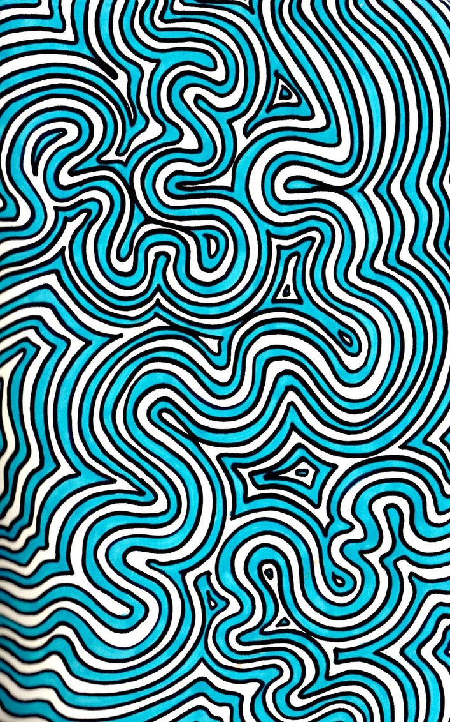
A) Matching
E)
9. Squiggly Lines

Slide 12
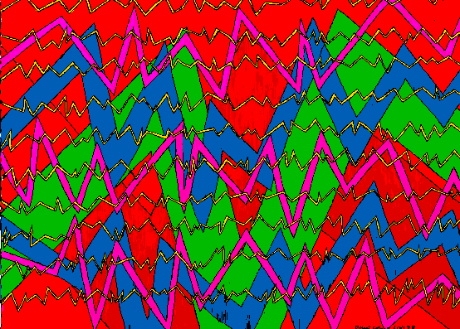
A) Matching
i)
10. Zig-Zag Lines

Slide 13
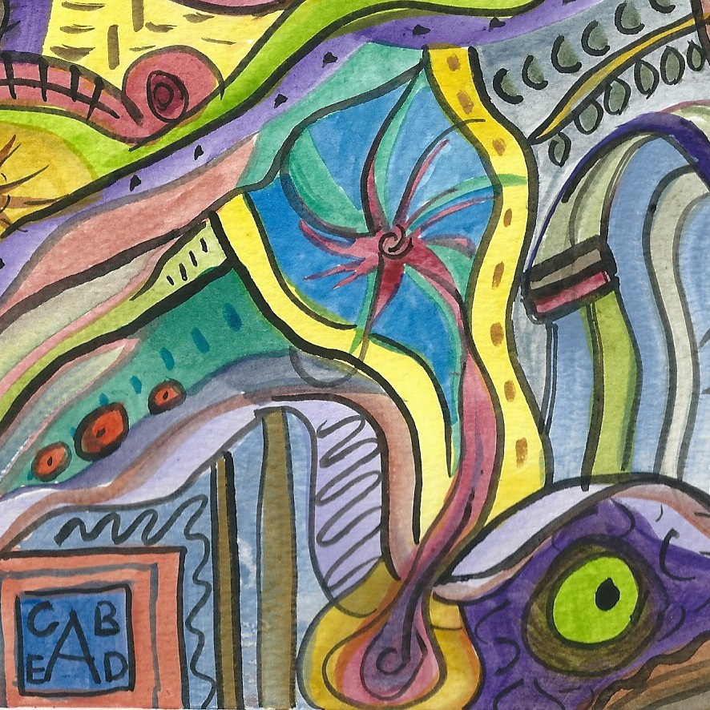
TOTAL Mark out of
/10

Slide 14

Matching:
Organic
Or
Geometric

Slide 15
Matching:
Organic
Or
Geometric

Slide 16
Matching:
Organic
Or
Geometric

Slide 17
Matching:
Organic
Or
Geometric

Slide 18
Matching:
Overlapping
Size Variation
Position
Value

Slide 19
Matching:
Overlapping
Size Variation
Position
Value

Slide 20
Matching:
Overlapping
Size Variation
Position
Value

Slide 21
Matching:
Overlapping
Size Variation
Position
Value

Slide 22
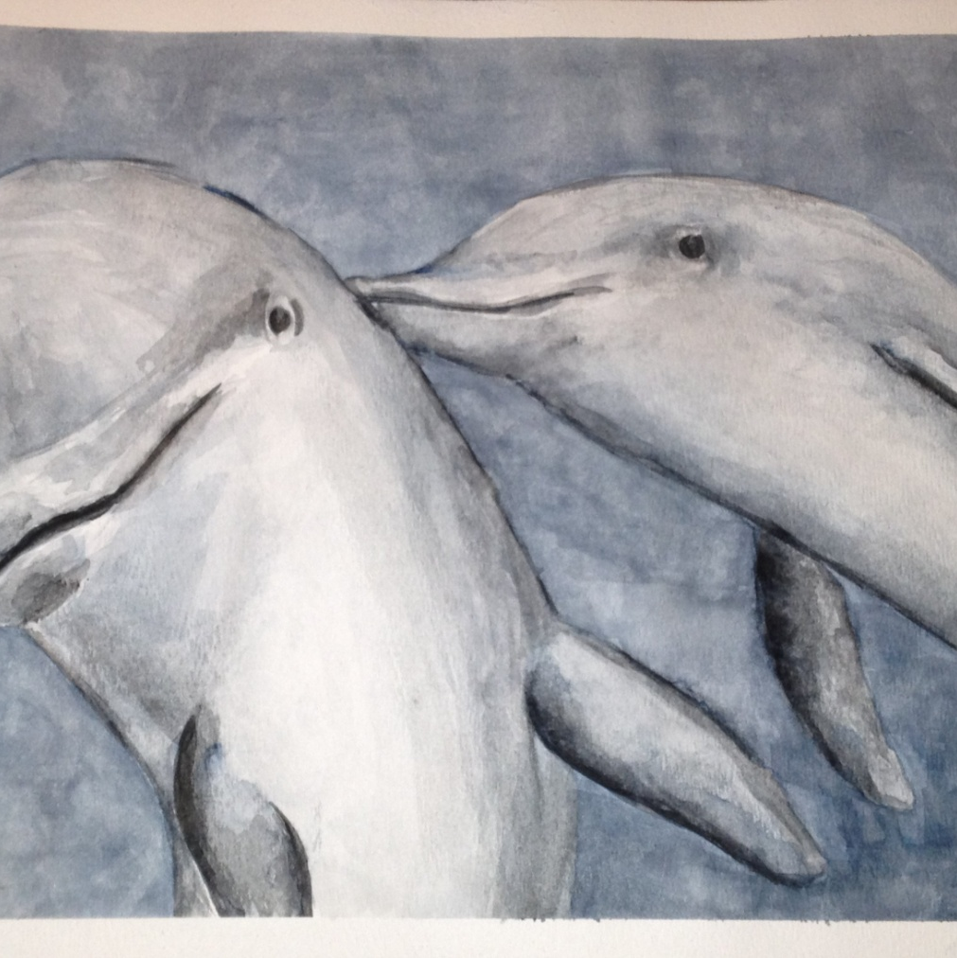
Total both matching sections
/8

Slide 23
Drawing:
Draw a:
Cube

Slide 24
Drawing:
Draw a:
Sphere

Slide 25
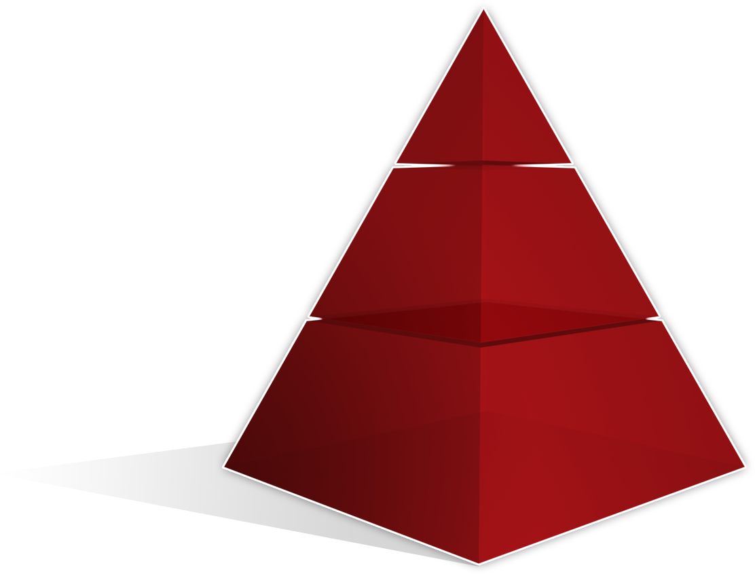
Drawing:
Draw a:
Pyramid

Slide 26
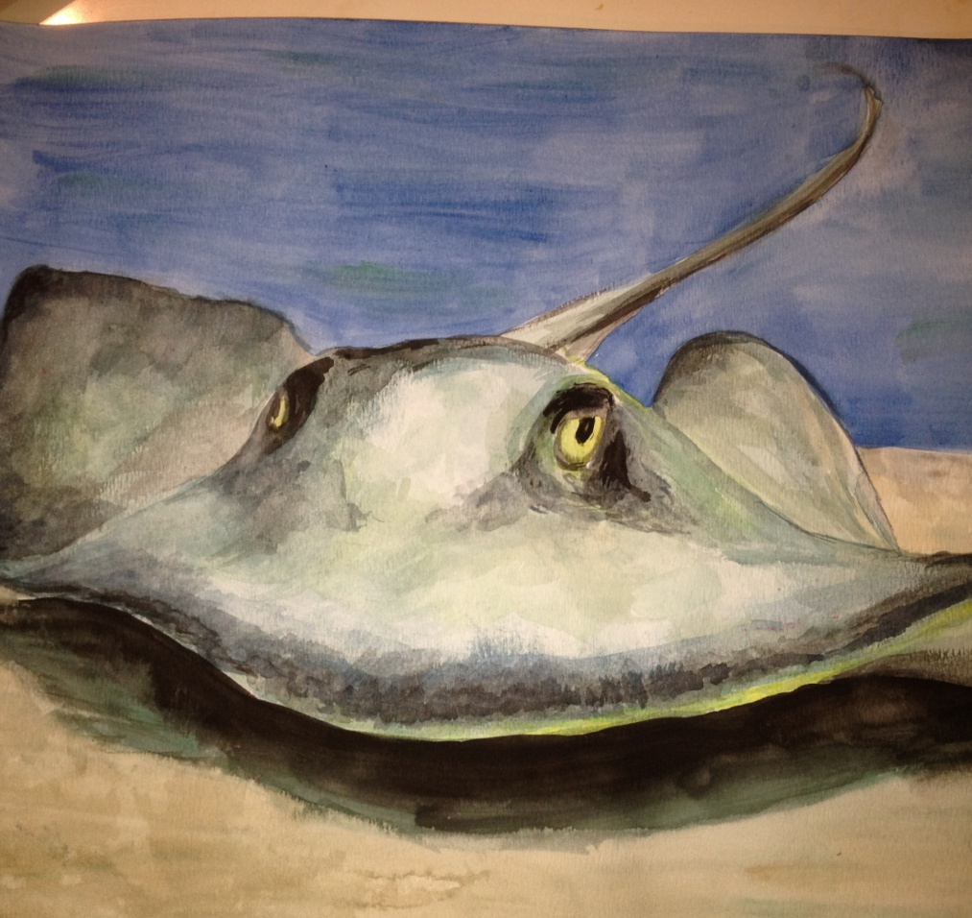
Total the Drawings out of /6
Total the Page out of
/14

Slide 27
Fill in the Blank:
1. What type of texture does an artist create using shading?
Implied Texture

Slide 28
Fill in the Blank:
2. List an intermediate colour:
Yellow-Orange
Blue-Violet
Red-Orange
Blue-Violet
Yellow-Green
Red-Violet

Slide 29
Fill in the Blank:
3. What are the neutral colours?
Gray
Black
White

Slide 30
Fill in the Blank:
4. What are the primary colours
Red
Yellow
Blue

Slide 31
Fill in the Blank:
5. What colour do you get when you mix Yellow and Blue together?
Green

Slide 32
Fill in the Blank:
6. What type of texture can we feel and touch?
Real Texture

Slide 33
Fill in the Blank:
7. What are the secondary colours?
Green
Violet
Orange

Slide 34
Fill in the Blank:
8. What are the warm colours?
Red
Orange
Yellow

Slide 35
Fill in the Blank:
9. What is the complimentary colour of Violet?
Yellow

Slide 36
Fill in the Blank:
10. What is the type of shape found in nature?
Organic Shape

Slide 37
Fill in the Blank:
11. The cool colours are: Violet, Blue and _______?
Green

Slide 38
Fill in the Blank:
12. What is the type of shape that is man made?
Geometric

Slide 39
Fill in the Blank:
13. When you add Black to a colour you are creating a _______?
Shade

Slide 40
Fill in the Blank:
14. When you add White to a colour you are creating a ________?
Tint

Slide 41
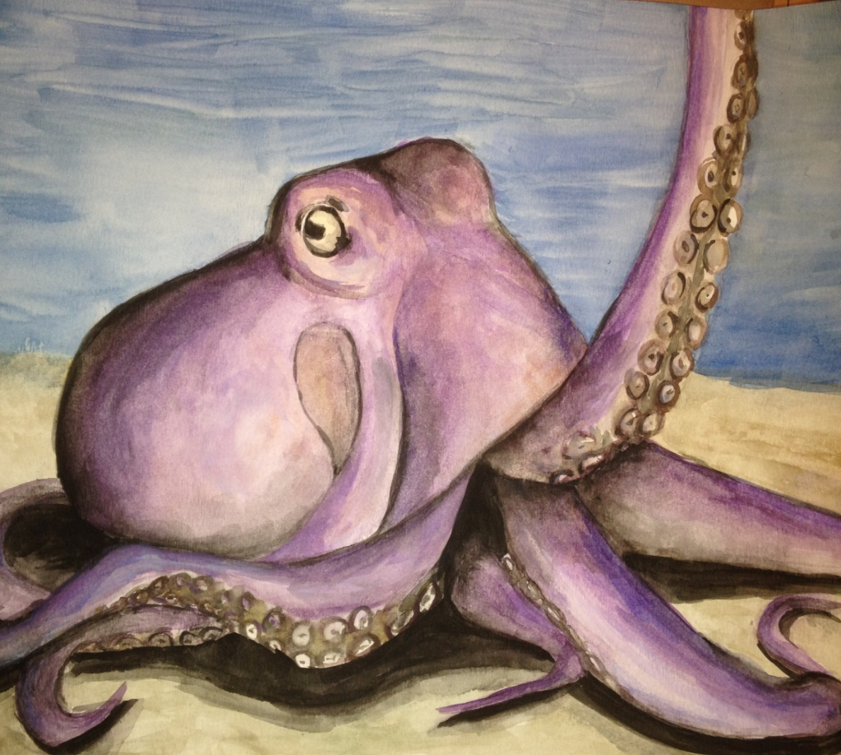
Total up your marks
Each is worth one mark
Out of
/22

Slide 42
Value Scale
Fill in the value scale by shading or hatching.
/5

Slide 43
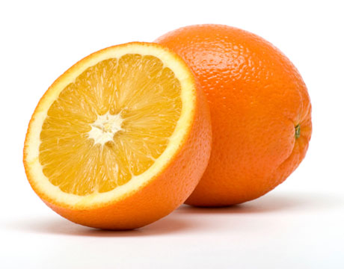
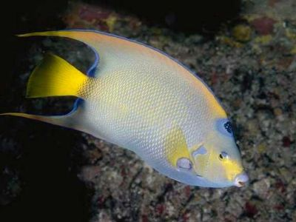
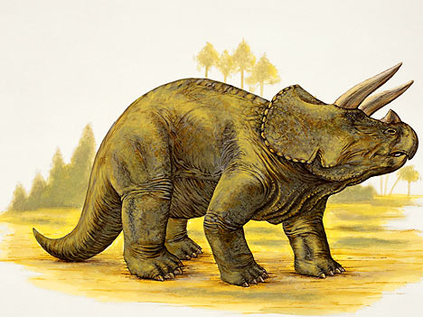
Draw one of the following /9

